Slide 1


Phonics at Eastling

Slide 2
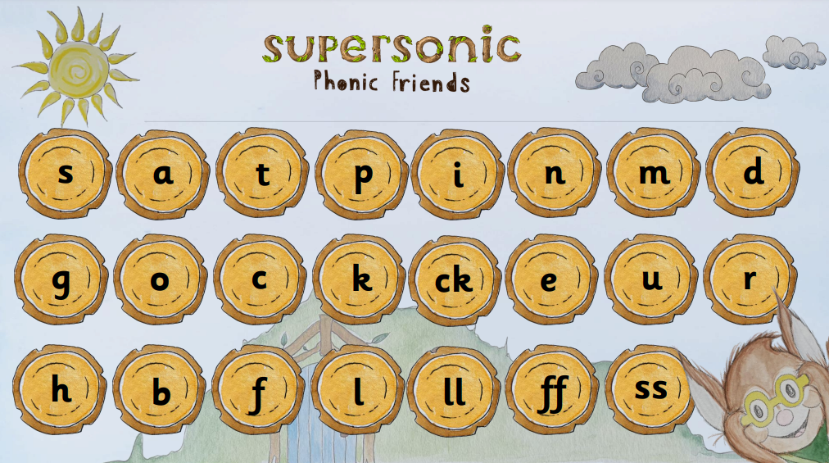
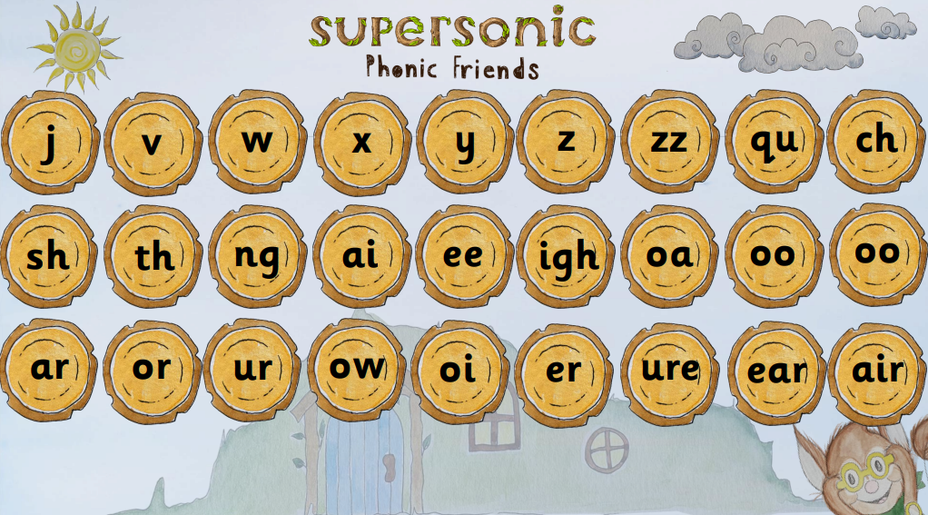

Slide 3
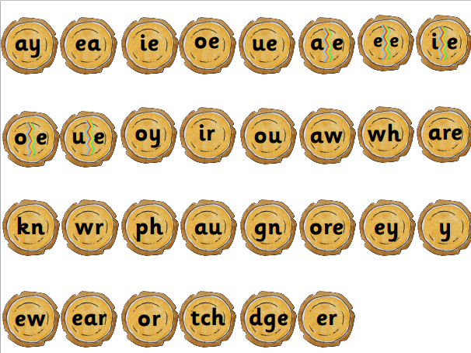
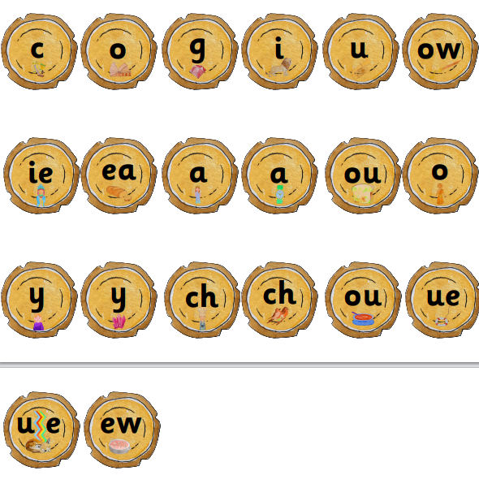

Slide 4
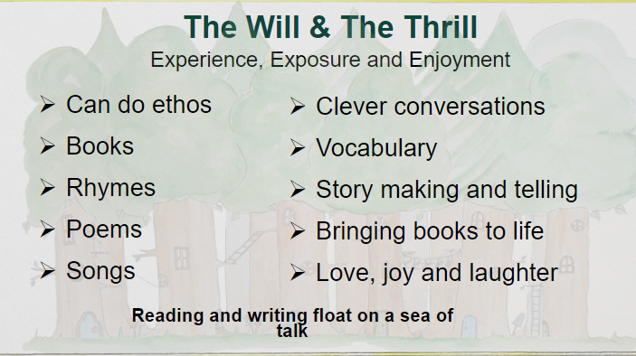

Slide 5
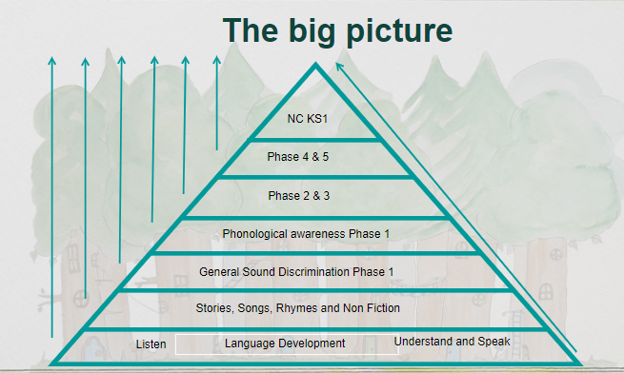

Slide 6
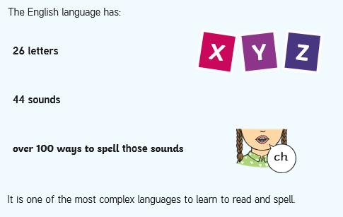
Did You Know…?

Slide 7
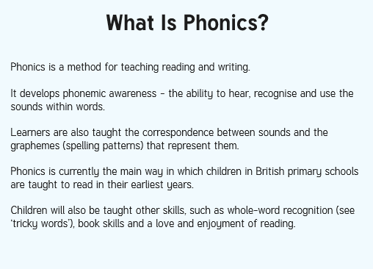
What is Phonics?

Slide 8
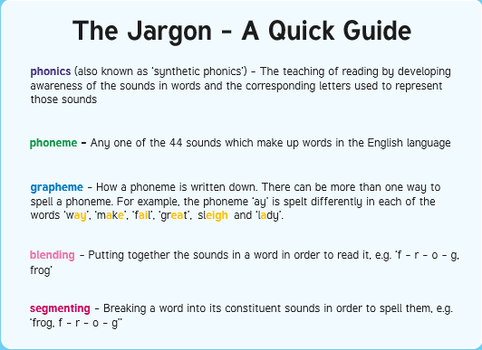
The Jargon – A Quick Guide
Digraph – two letters, one sound e.g sh, ch, th, ng, nk, qu
Trigraph – three letters, one sound e.g igh,

Slide 9
Phonic sessions are taught at Eastling Primary School in a whole class, structured programme of daily lessons from the beginning of Foundation Stage to the end of Year 2. We follow the Supersonic Phonic Friends validated scheme, providing a systematic, synthetic approach to the teaching of phonics. This programme is supported by children accessing consolidation provision throughout the school day and at home. Children who need additional phonic input have discreet programmes tailored to their phonic awareness and development throughout the week.
Phonics is taught in a variety of ways, including high quality modelling of sounding out, decoding, segmenting and blending strategies. Interactive resources and games are used and children are given the opportunity to rehearse sounds verbally and record them in written work.
Phonics sessions are structured to build on previous learning and introduce new phonics skills and subject knowledge. Sessions often follow the revisit/review, teach, practise and apply model. Sessions are planned to include opportunities for development of speaking and listening, reading and writing. The school spelling programme complements the phonics learning from Reception through to the end of KS2.

Slide 10
The Supersonic Phonic Friends scheme is grouped into phases - pupils’ progress from Firm Foundations, through the Basics 2, 3, and 4, onto the Higher Levels 5 Choose to Use and Switch it Spell it programmes before the children move into the National Curriculum spelling rules. These phases ensure that children advance from talking about and exploring sounds, through to understanding what graphemes and phonemes are. Pupils learn about GPCs (grapheme-phoneme correspondences), consonant digraphs, vowel digraphs and tri-graphs. Children develop knowledge of how to blend and segment the phonemes within words, including those with adjacent consonants.

Slide 11
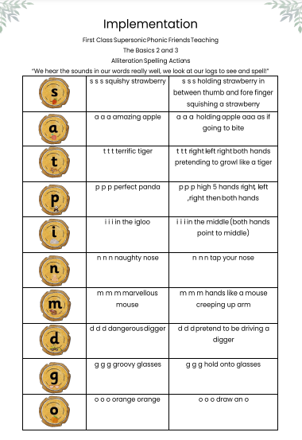
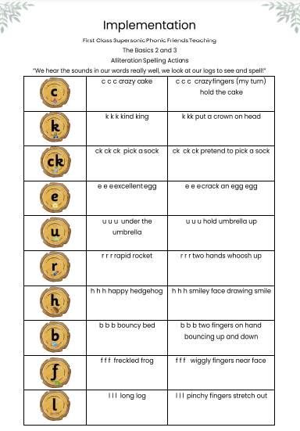
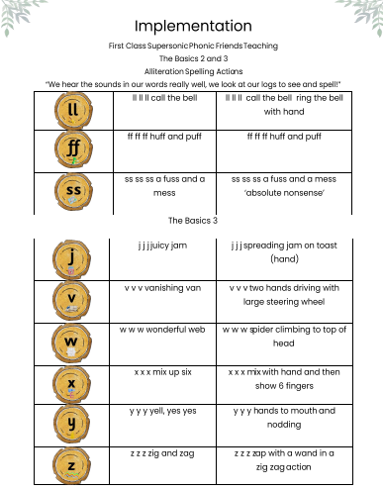

Slide 12
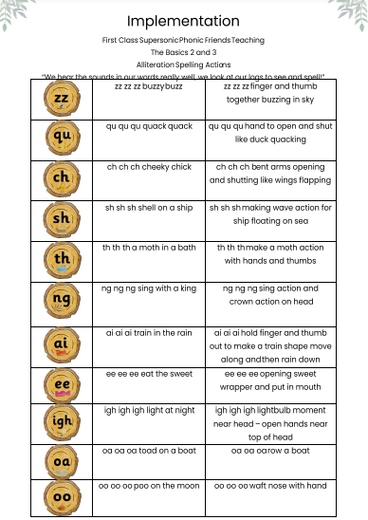
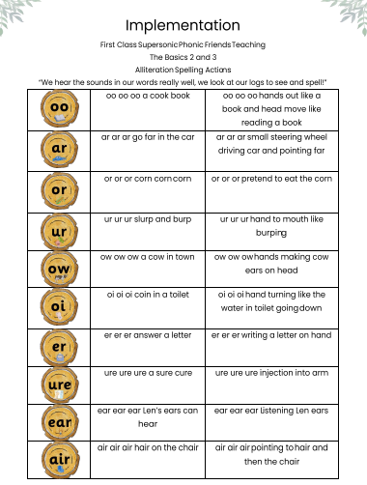

Slide 13
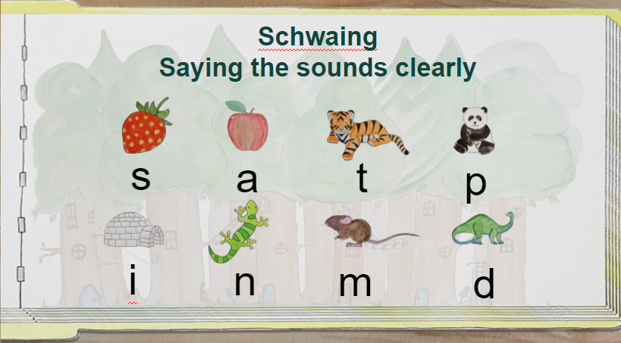

Slide 14
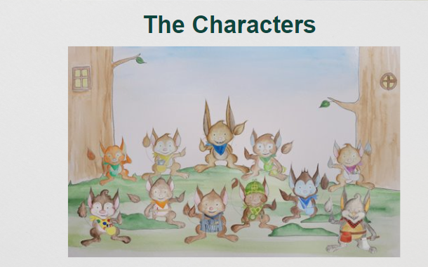

Slide 15
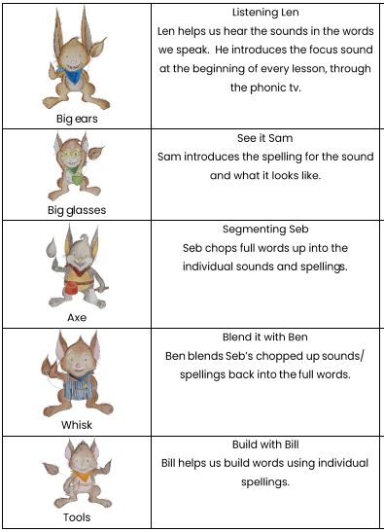
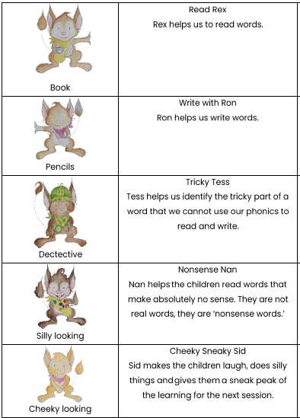
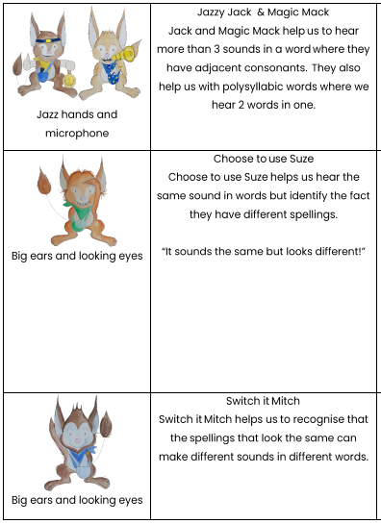

Slide 16
The Importance of Listening Skills
The first phase of formal phonics education (Firm Foundations) focuses on key listening skills. Without these skills, children may struggle to master the next stage of their phonics learning. This is because children with poor listening and/or attention skills can struggle with phonics as phonics learning relies on children being able to hear and distinguish the sounds within words. The emphasis during Firm Foundations is to get children attuned to the sounds around them and ready to begin developing oral blending and segmenting skills.

Slide 17
Firm Foundations
Children in Reception begin with Firm Foundations, which gives children playful daily repeated experience, exposure and enjoyment of general sound discrimination (environmental sounds, instrumental sounds and body percussion) and phonological awareness (rhythm and rhyme, alliteration and oral blending and segmenting). Although children move onto the Basics next, this Firm Foundation phase does not end as phonological awareness continues from the Basics to the Higher Levels of phonics and into spelling rules and patterns.
Each aspect contains three strands: Tuning in to sounds (auditory discrimination), Listening and remembering sounds (auditory memory and sequencing) and Talking about sounds (developing vocabulary and language comprehension).

Slide 18
Firm Foundations Aspects
Aspect 1 - General sound discrimination - environmental
The aim of this aspect is to raise children's awareness of the sounds around them and to develop their listening skills. Activities suggested in the guidance include going on a listening walk, drumming on different items outside and comparing the sounds, playing a sounds lotto game and making shakers.
Aspect 2 - General sound discrimination - instrumental sounds
This aspect aims to develop children's awareness of sounds made by various instruments and noise makers. Activities include comparing and matching sound makers, playing instruments alongside a story and making loud and quiet sounds.

Slide 19
Aspect 3 - General sound discrimination - body percussion
The aim of this aspect is to develop children's awareness of sounds and rhythms. Activities include singing songs and action rhymes, listening to music and developing a sounds vocabulary.
Aspect 4 - Rhythm and rhyme
This aspect aims to develop children's appreciation and experiences of rhythm and rhyme in speech. Activities include rhyming stories, rhyming bingo, clapping out the syllables in words and odd one out.
Aspect 5 - Alliteration
The focus is on initial sounds of words, with activities including I-Spy type games and matching objects which begin with the same sound.
Aspect 6 - Voice sounds
The aim is to distinguish between different vocal sounds and to begin oral blending and segmenting.
Aspect 7 - Oral blending and segmenting
In this aspect, the main aim is to develop oral blending and segmenting skills. To practise oral blending, the teacher could say some sounds, such as /c/-/u/-/p/ and see whether the children can pick out a cup from a group of objects. For segmenting practise, the teacher could hold up an object such as a sock and ask the children which sounds they can hear in the word sock.
The activities introduced in Firm Foundations are intended to continue throughout the following phases, as lots of practice is needed before children will become confident in their phonic knowledge and skills.

Slide 20
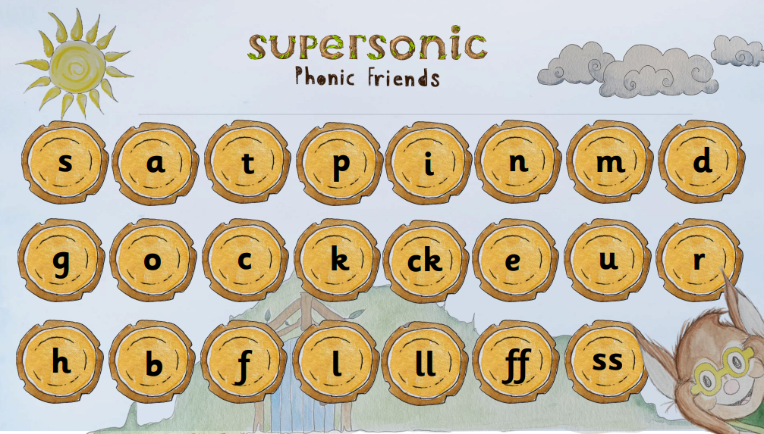
Basics 2

Slide 21
Basics 2
Children are introduced to the Basics 2, which marks the start of systematic phonic work. Grapheme-phoneme correspondence is introduced. The process of segmenting whole words and selecting letters to represent those phonemes is taught. Children learn at least one spelling for 18 of the 44 sounds of the English language and make phonetically plausible attempts in their emerging stages of spelling in their writing journey. Children will be able to read decodable books containing the Basics 2 graphemes.
Letters and their sounds are introduced one at a time. A set of letters is taught each week, in the following sequence:
Group 1 - s a t p
Group 2 - i n m d
Group 3 - g o c k
Group 4 - ck e u r
Group 5 - h b f l
Group 6 – ll ff ss
As soon as each set of letters is introduced, children will be encouraged to use their knowledge of the letter sounds to blend and sound out words. For example, they will learn to blend the sounds s-a-t to make the word sat. They will also start learning to segment words. For example, they might be asked to find the letter sounds that make the word tap from a small selection of magnetic letters.

Slide 22
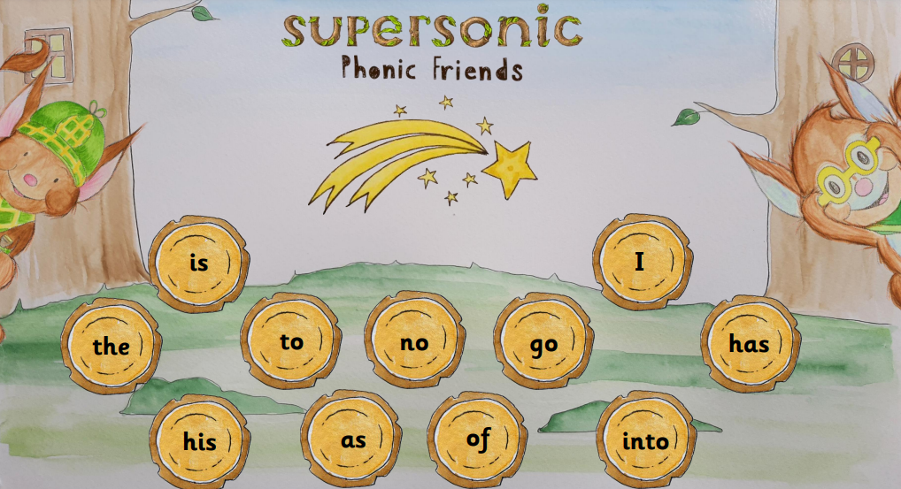
Basics 2 HFW & Tricky Words
There are 45 high frequency words children are expected to be able to sight read by the end of the Reception Year. These are a mix of decodable words and common exception words (those tricky words children have to be able to see and say as they can’t be read phonetically!)
HFW’s: a, dad, mum, big, it, at, on, up, back, if, but, him, had, in, got, an, can, off, not, get, and.

Slide 23
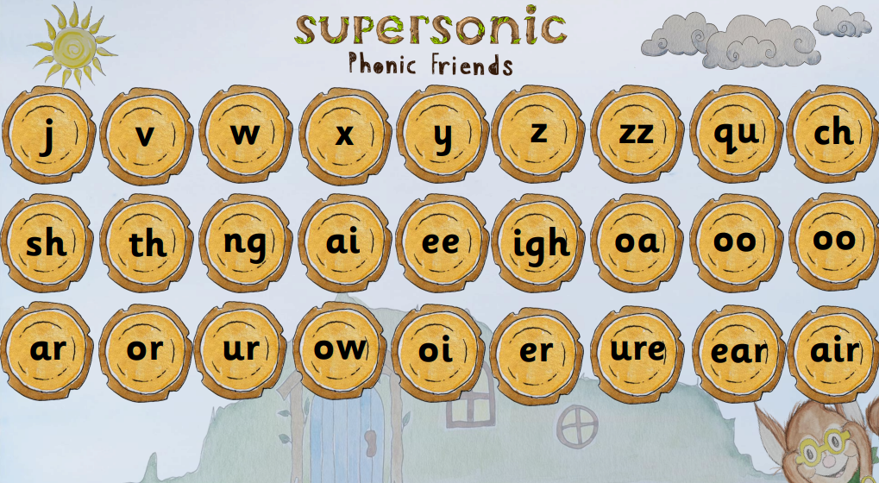
Basics 3 Sounds

Slide 24
Basics 3
The Basics 3 completes the teaching of the alphabet and then moves on to cover sounds represented by more than one letter, learning one representation for each of the 44 phonemes. At this stage just one grapheme (spelling) is given for each phoneme. Children will make phonetically plausible attempts in their early stages of spelling in their writing journey. Children will be able to read decodable books containing the Basics 2 and 3 graphemes.
Group 1 - j v w x
Group 2 - y z, zz qu
Group 3 – ch sh th ng
Group 4 - ai, ee, igh, oa
Group 5 – oo oo ar or
Group 6 - ur ow oi er
Group 7 – ure ear air
During Basics 3, children will also learn the letter names, although they will continue to use the sounds when decoding words.

Slide 25
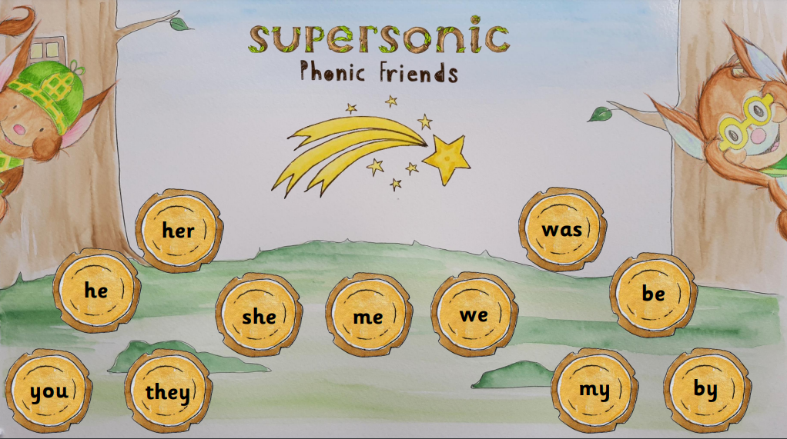
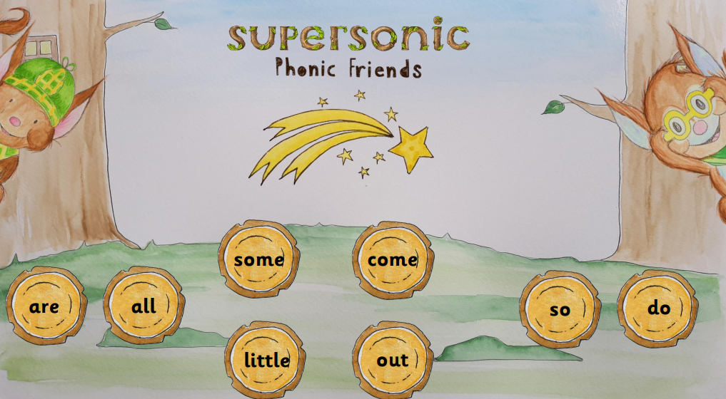
Basics 3 HFW & Tricky Words
HFW’s: will, that, then, now, this, with, for, them, down, see, too, look.

Slide 26
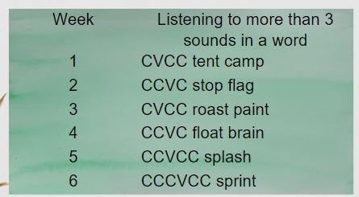
Basics 4
When children start Basics 4, they will know a grapheme for each of the 42 phonemes. They will be able to blend phonemes to read CVC (consonant-vowel-consonant) words and segment in order to spell them.
Children will also have begun reading straightforward two-syllable words and simple captions, as well as reading and spelling some tricky words.
In Basics 4, no new graphemes are introduced. They start to read and spell words containing adjacent consonants and four to six sounds. They will be able to read, spell and write CVC, CVCC, CCVC, CCVCC, CCCVC words (C = consonant, V = vowel), read decodable texts containing the Basics 2 and 3 graphemes with adjacent consonants and make phonetically plausible attempts in their evolving stages of spelling in their writing journey.

Slide 27
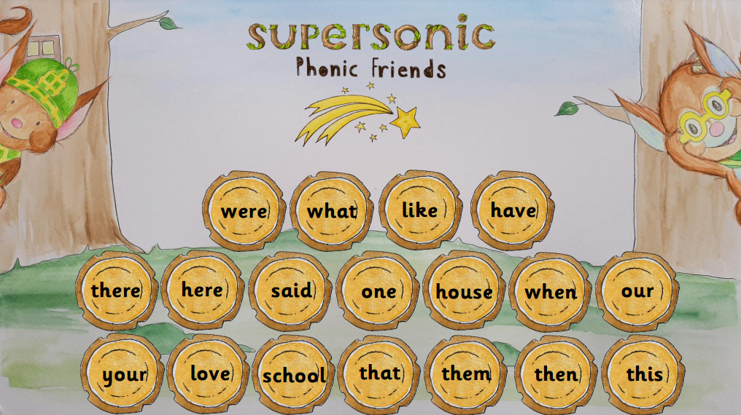
Basics 4 HFW & Tricky Words
HFW’s: went, from, children, it’s, just, help

Slide 28
Basics 5
Children entering Basics Five will already be able to read and spell words with adjacent consonants, such as trap, string and flask. They will also be able to read and spell some polysyllabic words.
In Basics Five, children will learn more graphemes and phonemes. For example, they already know ai as in rain, but now they will be introduced to ay as in day and a-e as in make.
Alternative pronunciations for graphemes will also be introduced, e.g. ea in tea, head and break.
With practice, speed at recognising and blending graphemes will improve. Word and spelling knowledge will be worked on extensively.

Slide 29
Within the Higher Levels 5 Choose to Use and Switch it Spell it, pupils progress to learning that there are more than one spelling for a sound they can hear in a word. Children learn about split digraphs, alternative pronunciations of the same grapheme, and alternative representations of the same phoneme.
They will be able to read, spell and write the 44 sounds in the English language, switch spellings and sounds for alternative pronunciations, read decodable texts containing the Basics to Higher Levels spellings including adjacent consonants and make more accurate attempts in their further stages of spelling in their writing journey.

Slide 30
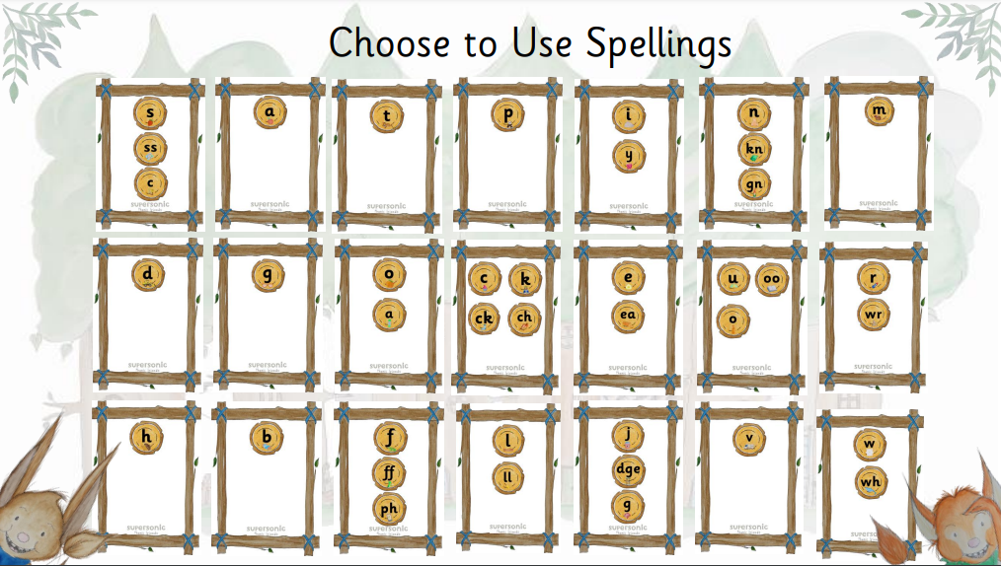
Year 1: Choose to Use

Slide 31
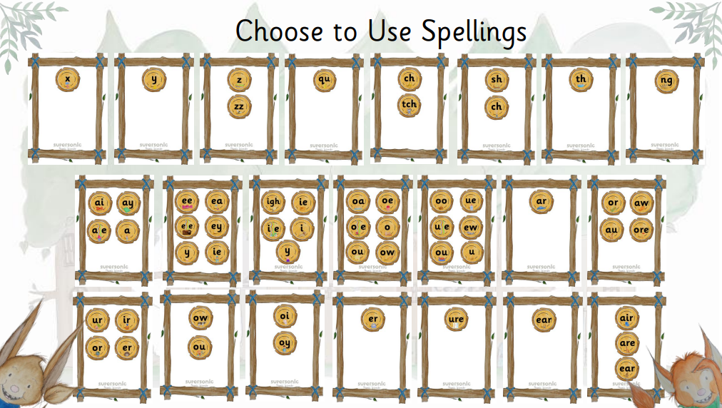

Slide 32
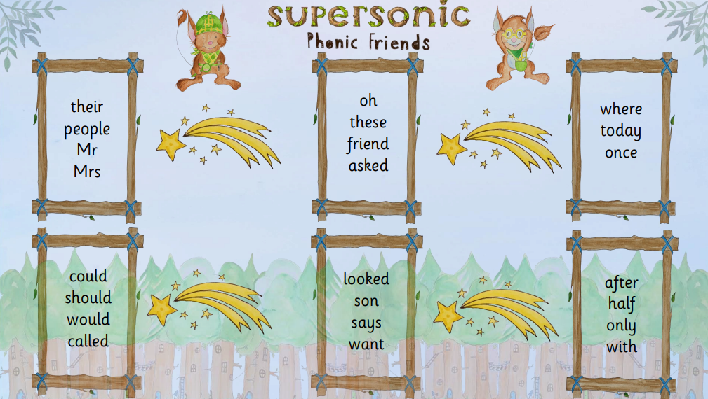
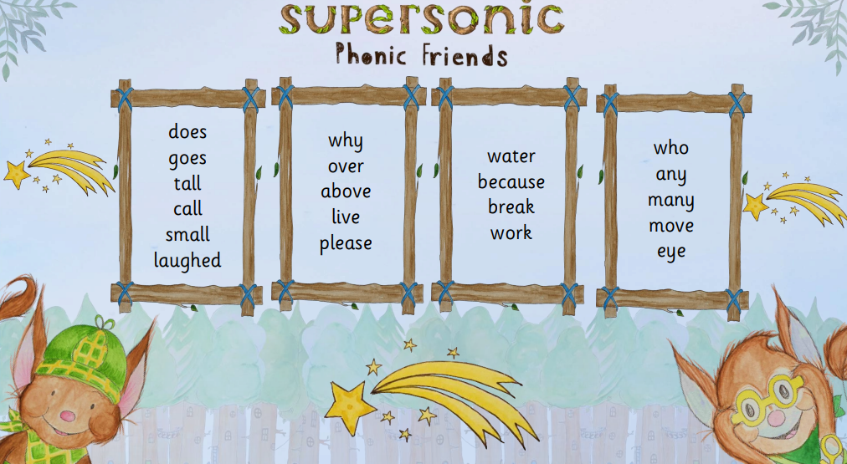
BAsics 5 HFW
HFW’s: made, came, saw, don’t, very, make, put, old, I’m, about, time, day

Slide 33
Year 2
In Year 2, children will have already learnt the most frequently occurring grapheme–phoneme correspondences (GPCs) in the English language. They will be able to read many familiar words automatically. When they come across unfamiliar words they will in many cases be able to decode them quickly and quietly using their well-developed sounding and blending skills. With more complex unfamiliar words they will often be able to decode them by sounding them out.
At this stage children should be able to spell words phonemically although not always correctly. In Year 2, the main aim is for children to become more fluent readers and more accurate spellers.

Slide 34
Once children have mastered the above, the curriculum concentrates on developing a variety of spelling strategies including homophones (word specific spellings) eg see/ sea, spelling of words with prefixes and suffixes, doubling and dropping letters where necessary. Also the accurate spelling of words containing unusual grapheme-phoneme correspondences eg. laughs, two. The reading and spelling of high frequency words are taught throughout the academic year, as part of phonic development, along with how to spell tricky words, which may not fit conventional spelling rules.

Slide 35
Year 1 Phonics Screen
Each June, all children in Year 1 undertake a National Phonics Screening Check. This check consists of 40 words (20 real words and 20 pseudo words) which the children will be required to read. The focus of this check is to see if pupils can decode a range of words that they have not seen before. The children who did not meet the required standard for the check in year, enter again in Year 2 after having additional support. As children enter KS2, provision is made for any children who may still require daily phonic

Slide 36
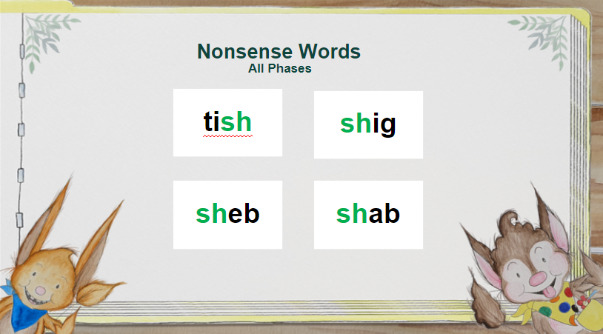

Slide 37
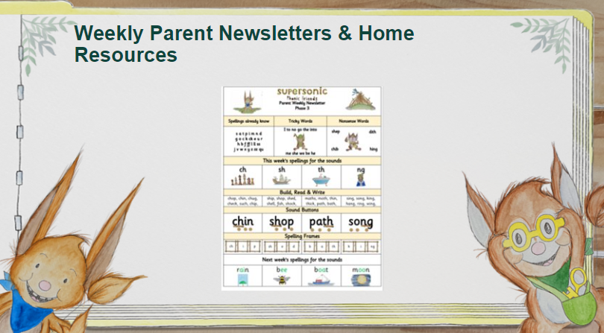

Slide 38
Practising Sounds and blending
Flashcards – having the sounds on cards help children to recognise and read the sounds at pace.
Orally blending – during conversations with your child, use the opportunity to segment VC and CVC words ie. Can you put the l-i-d i-n the b-i-n? Pause after each word to give your child the opportunity to blend the word aloud before continuing.
Initial sounds, medial sounds, end sounds – the first stage is to hear the initial sound in a word – if you are practising ‘s’, say a sentence using lots of words beginning with this sound ie. The sun is setting in the sky…The last sound in a word is often easy for children to hear and decode as it’s the final thing they hear and can be emphasised (although not at the expense of loosing the pure sound)! Medial sounds are trickier, as they are wedged in the middle. Practise stretching out the word so your child can really hear the sound.
Word building – use flashcards, sound pebbles, chalk, whiteboards, phonic cubes. Children can play around with sounds, building both real and nonsense words – this is key as it helps with Year 1 Phonics Screen.

Slide 39
Helping your child at home
Work on listening skills
Practise segmenting and blending
Look for familiar sounds and words in the environment
Practise new sounds and graphemes
Help your child to complete their phonics home learning
Read with your child, both hearing them and reading to them.
Play phonics games using sound flashcards, tablet games, I spy, etc.

Slide 40
Useful Links
http://ictgames.com/
https://www.phonicsplay.co.uk/
https://www.youtube.com/channel/UC7sW4j8p7k9D_qRRMUsGqyw Mr Thorne Phonics
Teach your monster to read
Most app stores have many good quality phonics games – a quick search will show you many results.

